Slide 1


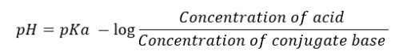
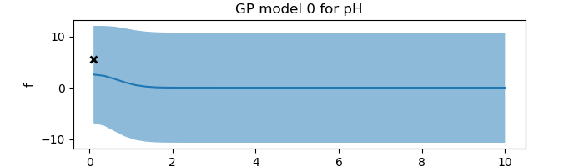
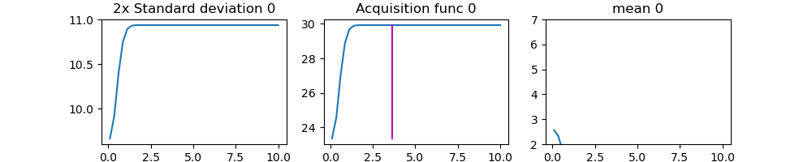
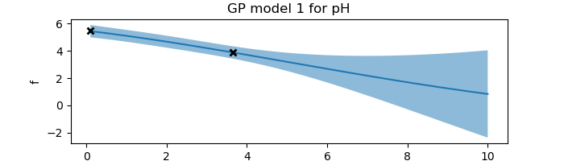
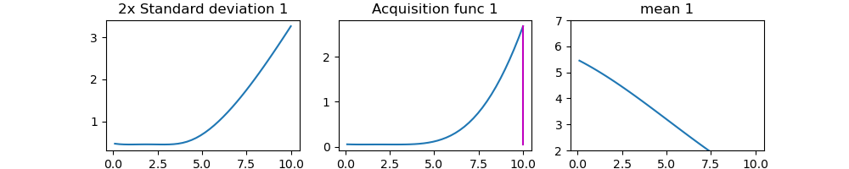
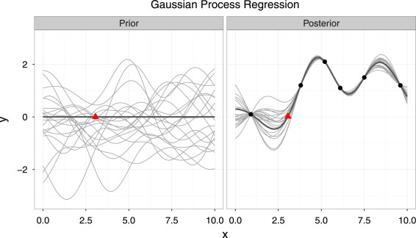
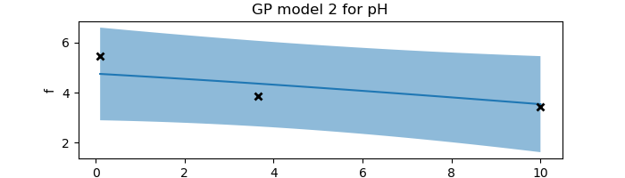
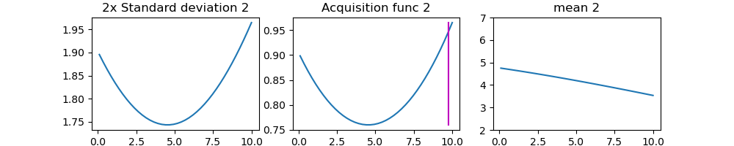
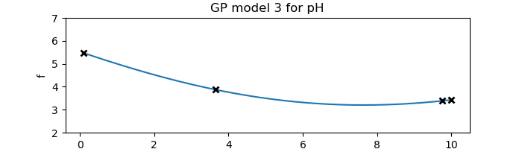
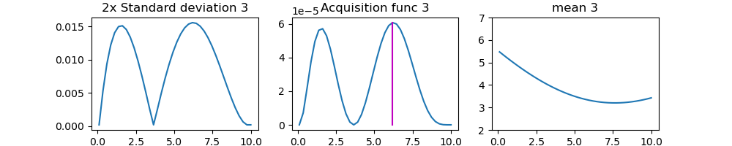
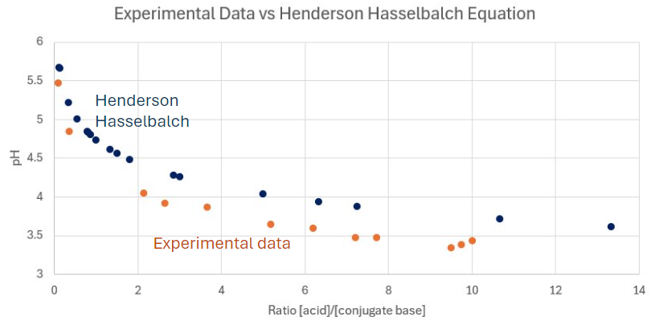
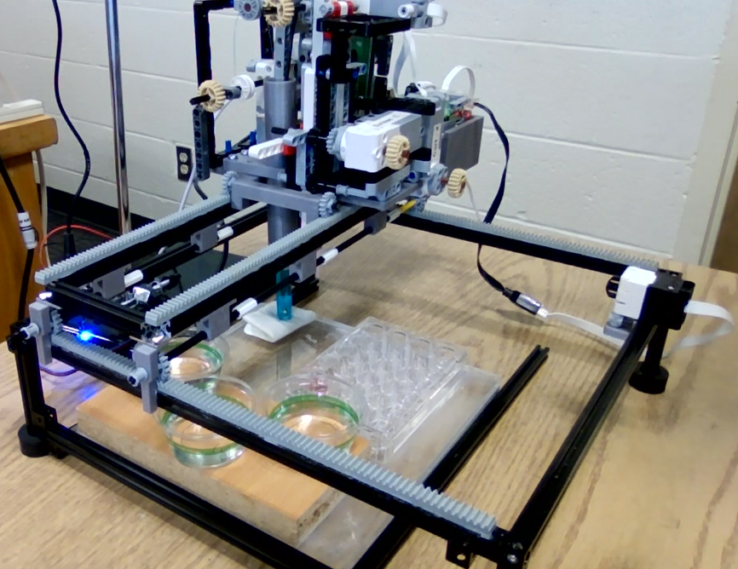
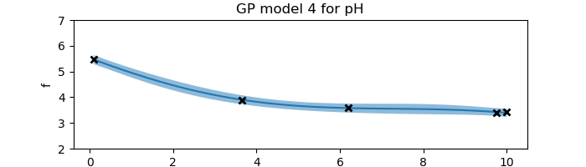
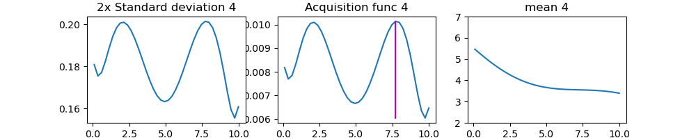
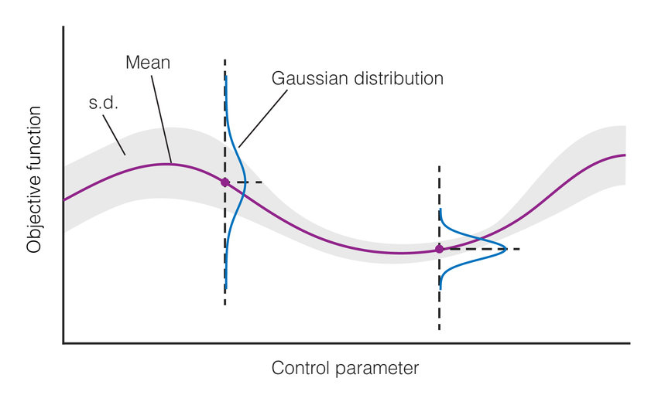
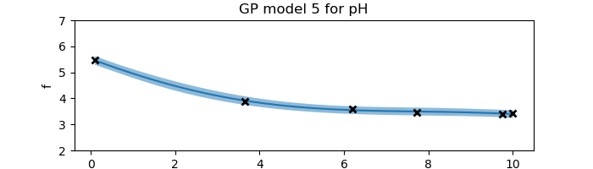
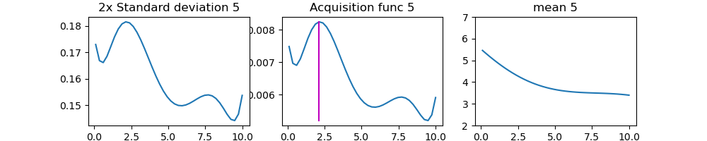
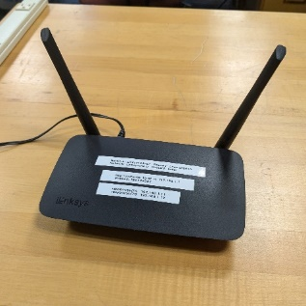
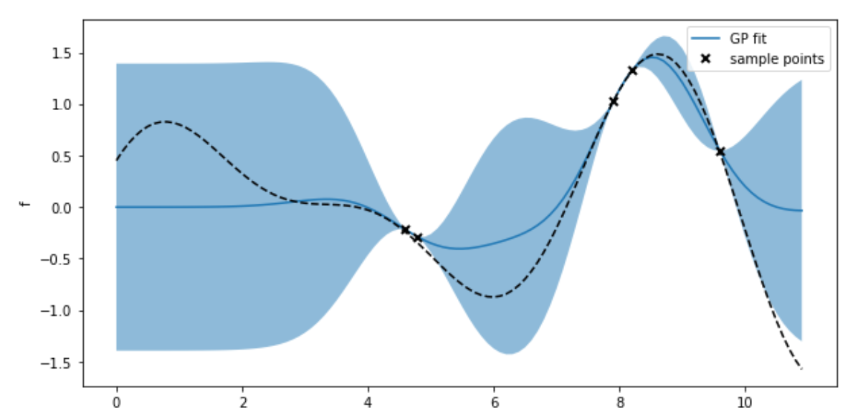
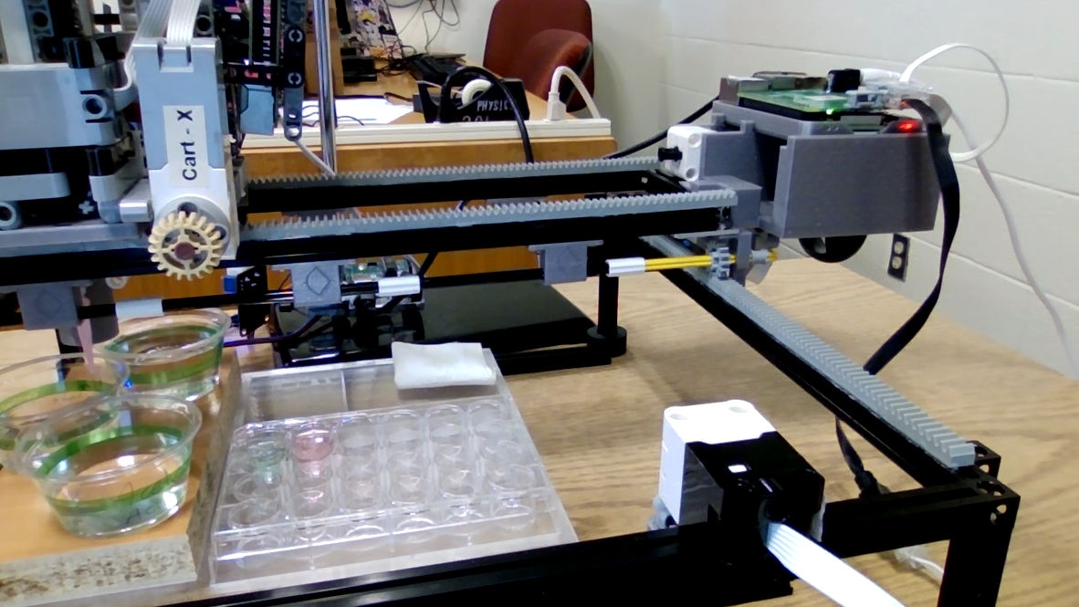
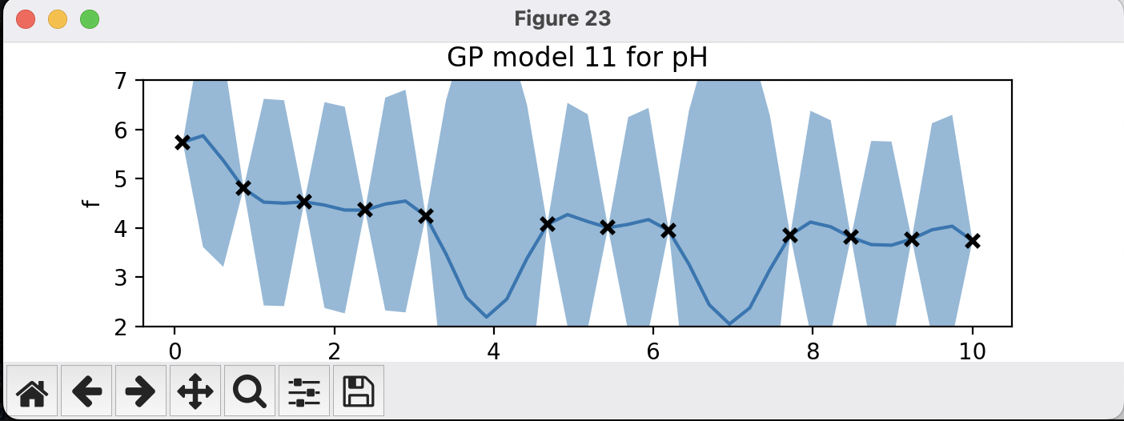
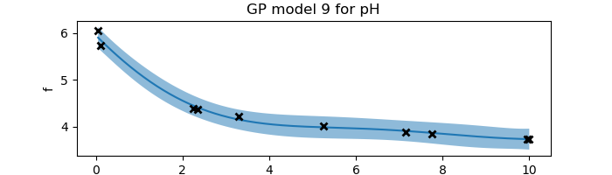
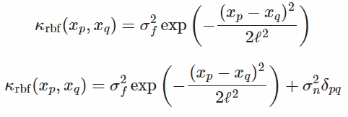
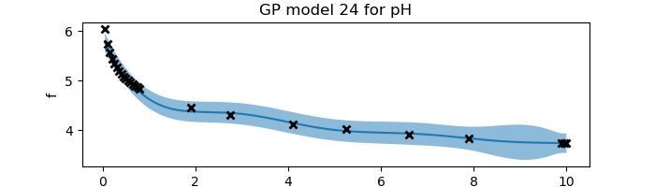
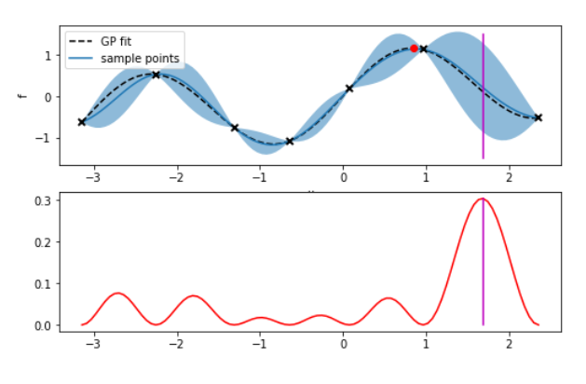
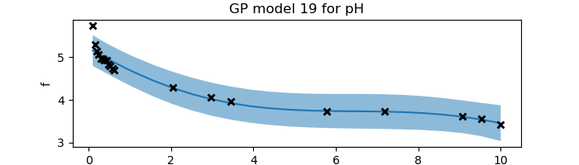
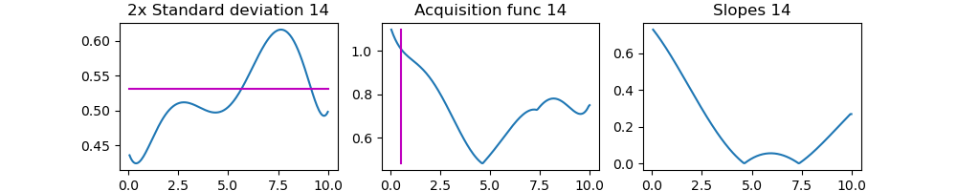
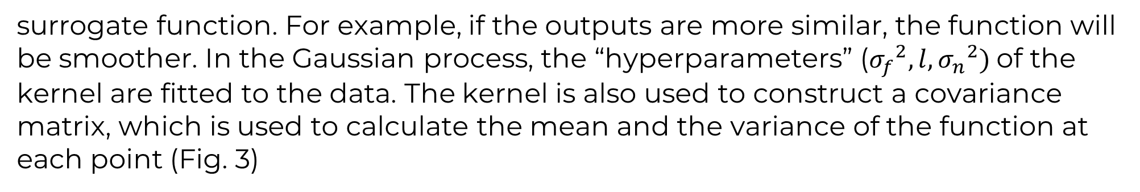
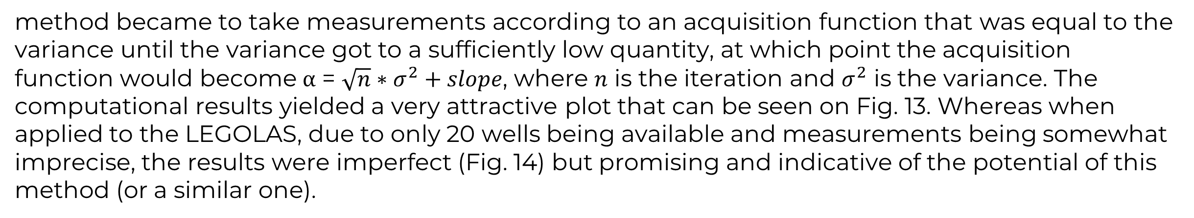
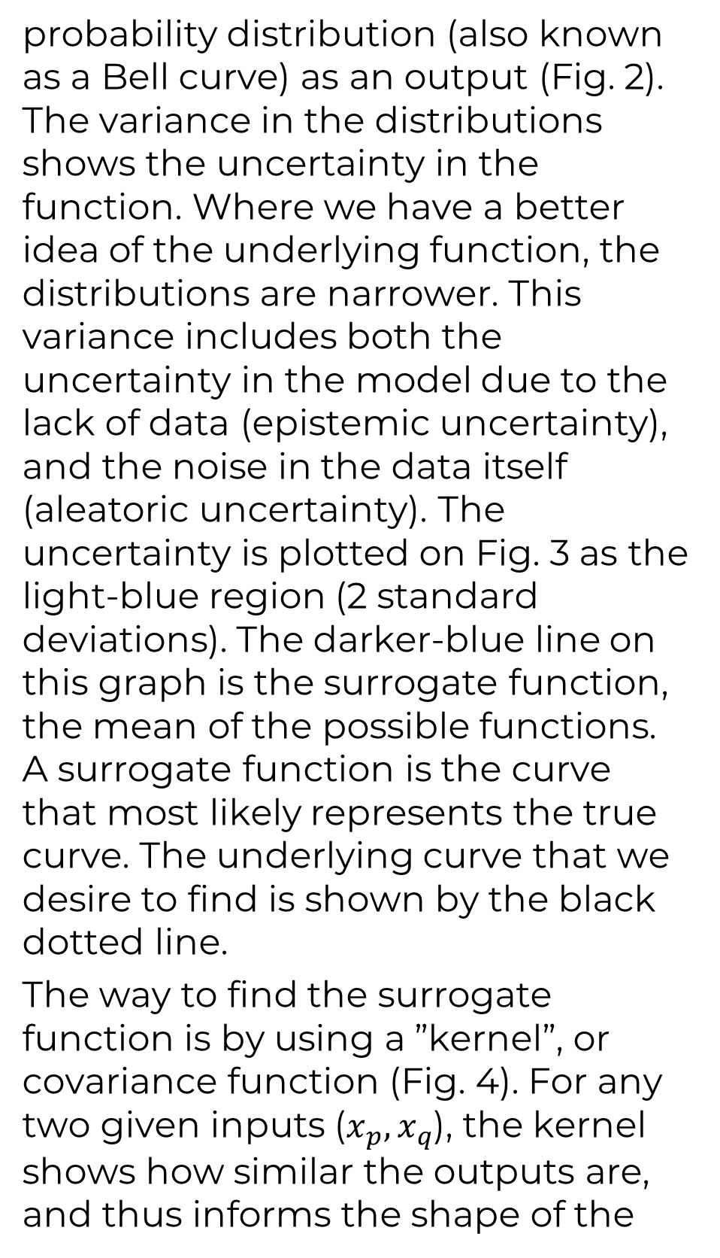
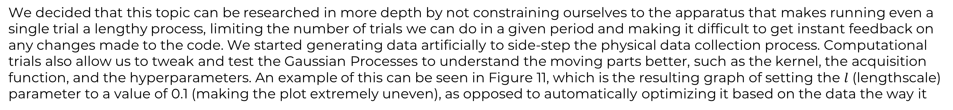
Automation and Machine Learning: How a Robot Can Conduct Its Own Experiments Using Gaussian Processes
Miller Gruen and Adi Timin - Hauber Research Fellowship 2024
Advisor: Dr Mary Lowe, Physics Department, Loyola University Maryland
Introduction
Experimental Results: “Exploration”
When researching, scientists often need to take large amounts of data and conduct numerous tests. Rather than taking many measurements that require time, resources, and money, it may be better to automate the task. Beyond automation, imagine if a device were able to do more than simply repeat a task, if it could make its own decisions and conduct an experiment wholly without needing constant human supervision. This could combat the complexity of research and optimize the taking of data, as well as greatly easing the burden on scientists in fields that require large amounts of testing, such as chemistry, physics, drug discovery, biology, and material synthesis. We can accomplish this using Gaussian processes applied to machine learning. Gaussian processes is a method of doing regression that enables you to find a quantitative model to describe the relationships in the data points. In our experiment, using a liquid handling robot, we applied Gaussian processes to determine the model and the sequence of data points to acquire, allowing the device to operate autonomously. The goal of this project was to understand both exploration and exploitation-based machine learning. We explored machine learning both experimentally and computationally. Our experiment could be viewed as proof of concept of a method that can be applied to many other disciplines, settings, and applications.
Our goal was to discover a quantitative model for the shape of the pH curve that results when mixing together an acid and a conjugate base. We chose to test the relationship between pH and a ratio of acid and conjugate base because the relationship is governed by a known equation: the Henderson Hasselbalch equation.
We selected a known relationship in order to understand the concepts of machine learning and to ensure its correct application.
Eq. 1
We used 0.1M Acetic Acid and 0.1M Sodium Acetate.
The curve begins as a line at 0, the mean of all infinite possibilities for the curve to take.
We began by taking a measurement at 0.1 ratio of the [acid]/[conjugate base]. With it, we obtained a curve with the uncertainty required to create an acquisition function, both shown to the left. From this, we obtained the next data point.
This continued until the curve was found.
Theory and Background
Apparatus
Gaussian processes is a method of doing regression to find a model that indicates which functions are most likely to describe the data obtained at any time during an experiment. When there are no data, the prior model includes all functions. Then as more data are observed, the number of possible functions decreases. The functions are non-parametric, which
LEGOLAS, which stands for LEGO-based low-cost autonomous scientist, is a robotic kit created by a team of students and faculty at the University of Maryland and the National Institute of Standards and Technology. Often devices for material synthesis are expensive, and machine learning is being studied to reduce the number of costly experiments and make data collection more efficient. LEGOLAS was created to be a low-cost accessible apparatus enabling machine learning to be taught in any setting.
Our data aligns with the shape of the known curve, showing that our function successfully gained the information about the curve created by this relationship.
Fig. 1
Fig. 10
means there is no equation that describes the function being fitted; there is only a curve described by a set of points.
In essence, a Gaussian process is a collection of normally distributed random variables. Thus, for each value of the control parameter, there is a Gaussian
Legolas possesses:
2 Raspberry Pis and Build Hats to control motors
5 Lego motors
1 Arduino
1 pH sensor
1 pipette with a plunger
Fig. 6
probability distribution (also known as a Bell curve) as an output (Fig. 2). The variance in the distributions shows the uncertainty in the function. Where we have a better idea of the underlying function, the distributions are narrower. This variance includes both the uncertainty in the model due to the lack of data (epistemic uncertainty), and the noise in the data itself (aleatoric uncertainty). The uncertainty is plotted on Fig. 3 as the light-blue region (2 standard deviations). The darker-blue line on this graph is the surrogate function, the mean of the possible functions. A surrogate function is the curve that most likely represents the true curve. The underlying curve that we desire to find is shown by the black dotted line.
The way to find the surrogate function is by using a ”kernel”, or covariance function (Fig. 4). For any two given inputs ($x_{p},x_{q}$), the kernel shows how similar the outputs are, and thus informs the shape of the
In the future, we hope to be able to test other acquisition functions and kernels, as well as explore other applications of machine learning.
Fig. 2
The Raspberry Pis connect wirelessly via a local network (Fig. 7) to a computer running the code and run the Lego motors using a Build Hat.
Fig. 7
Fig. 9: Code Outputs
Computational & Experimental Results: New acquisition function with “Exploitation”
Lego motor
We decided that this topic can be researched in more depth by not constraining ourselves to the apparatus that makes running even a single trial a lengthy process, limiting the number of trials we can do in a given period and making it difficult to get instant feedback on any changes made to the code. We started generating data artificially to side-step the physical data collection process. Computational trials also allow us to tweak and test the Gaussian Processes to understand the moving parts better, such as the kernel, the acquisition function, and the hyperparameters. An example of this can be seen in Figure 11, which is the resulting graph of setting the $l$ (lengthscale) parameter to a value of 0.1 (making the plot extremely uneven), as opposed to automatically optimizing it based on the data the way it
Fig. 3
Water
(rinsing)
Raspberry Pi and Build Hat
normally is. When running the test trials the data was generated based on the Henderson-Hasselbach equation. Noise was added to the data to try to imitate the behavior of the device (in most trials, the standard deviation was set to 0.1).
After running these tests, we realized there are many possibilities in working with the acquisition function.
Base
Fig. 11
Fig. 12
Acid
Limit switch
Fig. 4
Standards
Experimental wells
Fig. 8
We wanted to have the leftmost part of our function plotted more accurately as the previous trials didn’t do that so well (as seen on Fig. 12), so we decided to incorporate the slope of the curve into the acquisition function, meaning more measurements would be taken where the slope is greater. This can be useful not only in our case, but also whenever a function has an area where it changes drastically and requires more points to capture those changes. After many trials, our
Fig. 13
surrogate function. For example, if the outputs are more similar, the function will be smoother. In the Gaussian process, the “hyperparameters” (${σ_{f}}^{2}, l, {σ_{n}}^{2})$of the kernel are fitted to the data. The kernel is also used to construct a covariance matrix, which is used to calculate the mean and the variance of the function at each point (Fig. 3)
The code is written in Python and runs completely on a separate computer where the machine learning and Gaussian processes calculations are completed. We used a Jupyter Notebook to test and moved the code to a Python script for data collection.
The code is able to:
Establish communication between the computer and Raspberry Pis
Apply machine learning and regression
There are software functions for:
Moving the motors in the x and y directions
Pipetting liquid
Moving the pH sensor vertically
pH measurement
Rinsing and drying the pH sensor
We noticed that with “exploitation” (setting the acquisition function to the maximum value of the function – for experiments when we just want to find where the highest value is), the leftmost part of our function would be plotted most accurately, which lead us to
method became to take measurements according to an acquisition function that was equal to the variance until the variance got to a sufficiently low quantity, at which point the acquisition function would become ⍺ = $\sqrt{n}∗σ^{2}+slope$, where $n$ is the iteration and $σ^{2}$ is the variance. The computational results yielded a very attractive plot that can be seen on Fig. 13. Whereas when applied to the LEGOLAS, due to only 20 wells being available and measurements being somewhat imprecise, the results were imperfect (Fig. 14) but promising and indicative of the potential of this method (or a similar one).
This information is then used to determine the best data point to take next using an “acquisition function” that the scientist has specified. For instance, if the acquisition function is equal to the variance at each point (Fig. 5), a measurement will be taken where the uncertainty is highest, as shown by the vertical magenta line.
Fig. 14
Acknowledgements
References
Fig. 5
We wish to acknowledge Dr. Mary Lowe, the Loyola University Physics Department, the Hauber Research Fellowship Program, George Hall, Gilad Kusne, and the UMD and NIST team working on Legolas.
Add your information, graphs and images to this section.

